Slide 1
CLEAN ENERGY NAVIGATOR
TEAM HAJMOLA
SAJAY JK 23BCE2028 KARTHICK SAAI KT 23BCE2015

Slide 2
THE CHALLENGE- Hurdles to clean energy adoption
"In India, despite growing interest in renewable energy:
76% of potential adopters are confused about which clean energy solution fits their needs
82% are uncertain about the actual cost benefits and ROI65% struggle to find reliable local suppliers
70% lack clear understanding of government incentives and policies
This results in slower adoption of clean energy solutions, despite their clear environmental and economic benefits."

Slide 3
Solution
Clean Energy Navigator is an AI-powered platform that:
Analyzes user inputs (location, budget, energy usage) to recommend the best clean energy solutions
Calculates precise ROI and break-even points using real market data
Connects users with verified local suppliers
Provides sustainability scores for products
Offers AI-powered chat support for instant assistance

Slide 4
Key Features & Technology
Our platform leverages cutting-edge technology:
AI Recommendation Engine: Uses machine learning to analyze multiple data points
Provides personalized clean energy solutions
Adapts recommendations based on user feedback
Financial Analysis: Real-time ROI calculations
Break-even point analysis
Long-term profit projections
Location-Based Services: Integration with Geoapify API Maps nearby suppliers and installers
Real-time availability checking Sustainability
Scoring: AI-powered product analysis
Environmental impact assessment
Smart Chatbot: Powered by Google's Gemini API 24/7 customer support
Personalized guidance

Slide 5
Market Opportunity
The Indian renewable energy market is projected to reach $226 billion by 2026, with:
40% annual growth in residential solar adoption
35% increase in clean energy investments
Government target of 500 GW renewable energy by 2030
Rising electricity costs driving demand for alternatives

Slide 6
Business Model
Revenue streams include:
Commission from supplier referrals
Premium subscription services
Consultation fees for large-scale projects
Data insights licensing
API access fees
Sponsored Content and Partnerships
Data Analytics and Reporting

Slide 7
Competitive Analysis
While there are existing players in the market:
Competitors: Traditional energy consultants
Generic e-commerce platforms
Individual supplier websites
Our Advantages: AI-powered personalization , Comprehensive solution comparison , Sustainability scoring system , End-to-end user journey support with chatbot assistance

Slide 8
Future Roadmap
Expansion to all Indian cities and towns
Integration with smart home systems
Mobile app development
B2B enterprise solutions
International market entry
Real time weather data to find best results

Slide 9
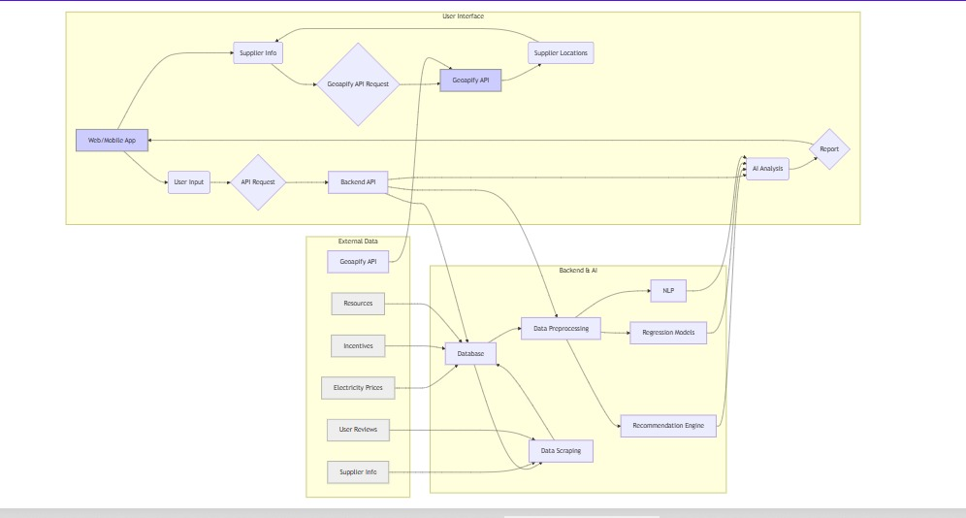
ARCHITECTURE MODEL

Slide 10
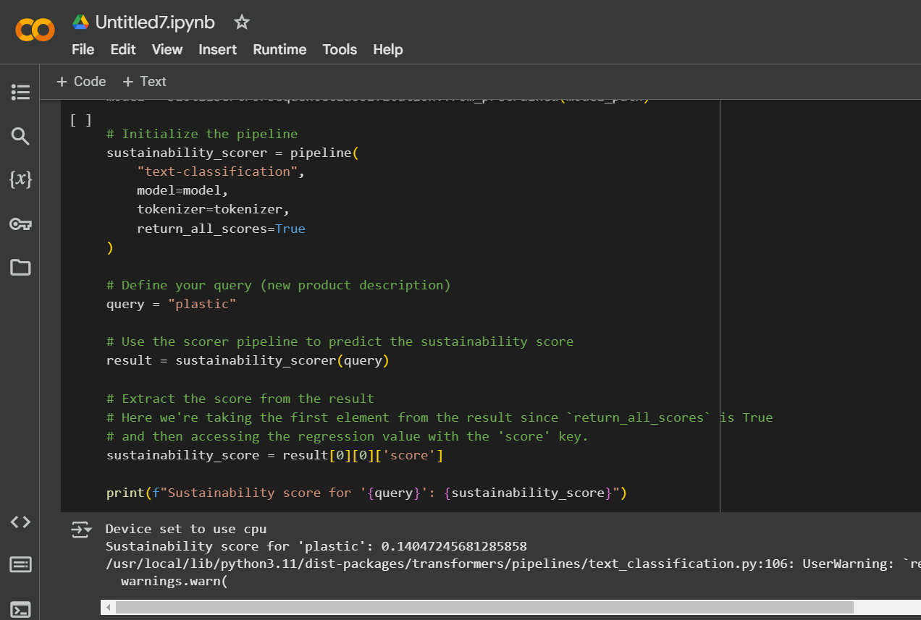
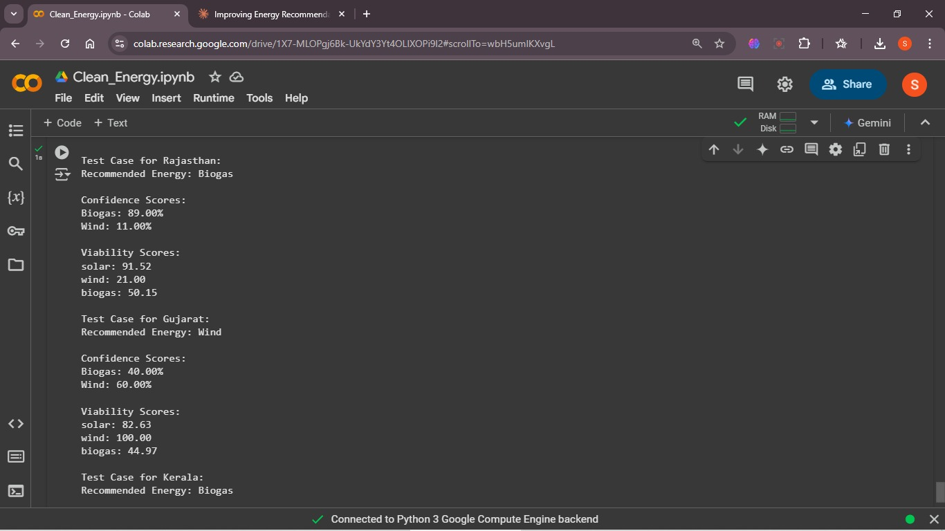
DistilBERT Model
RANDOM FOREST CLASSIFIER

Slide 11
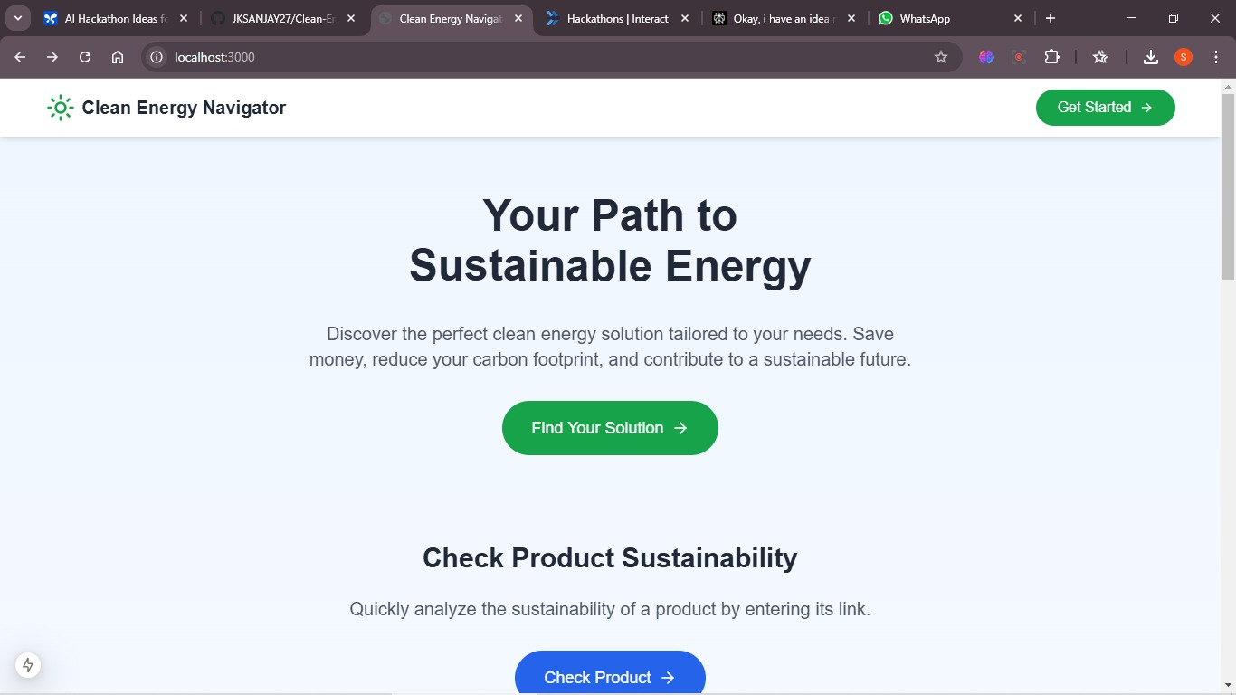
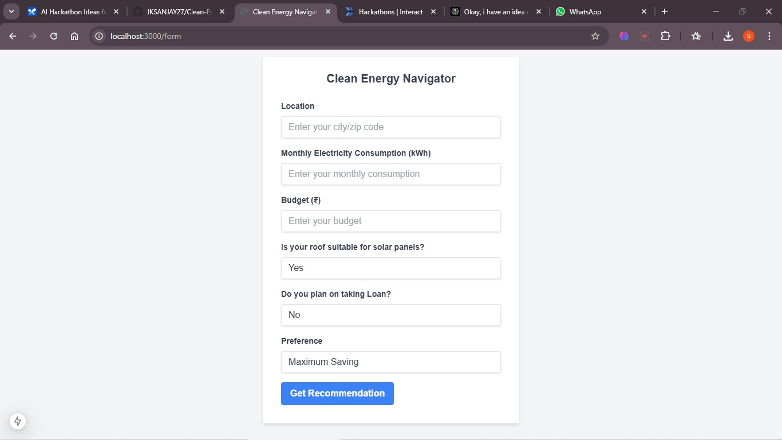

Slide 12
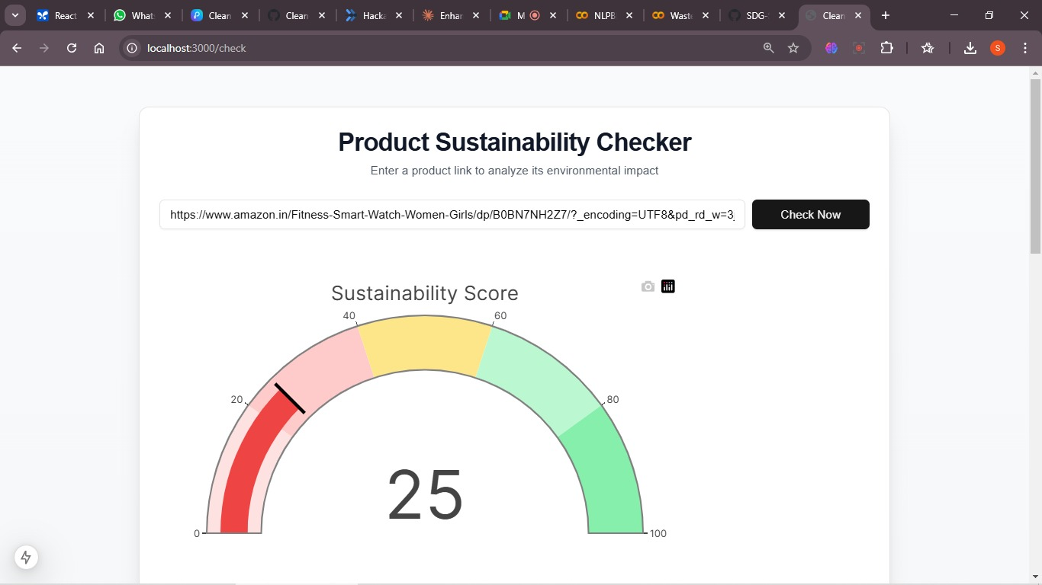
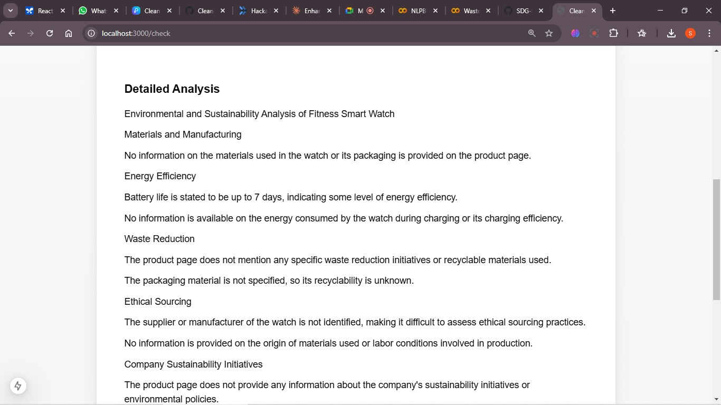

Slide 13
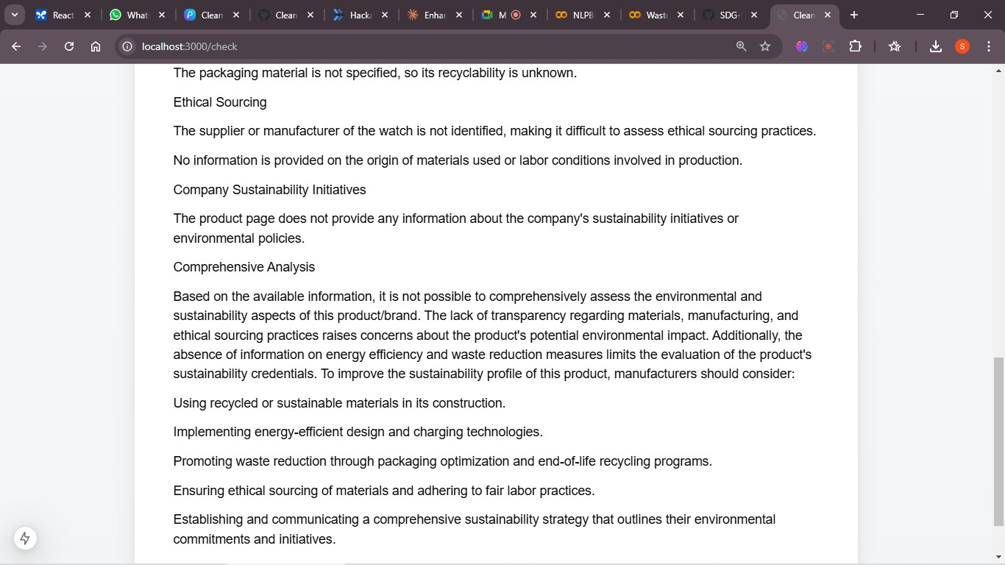
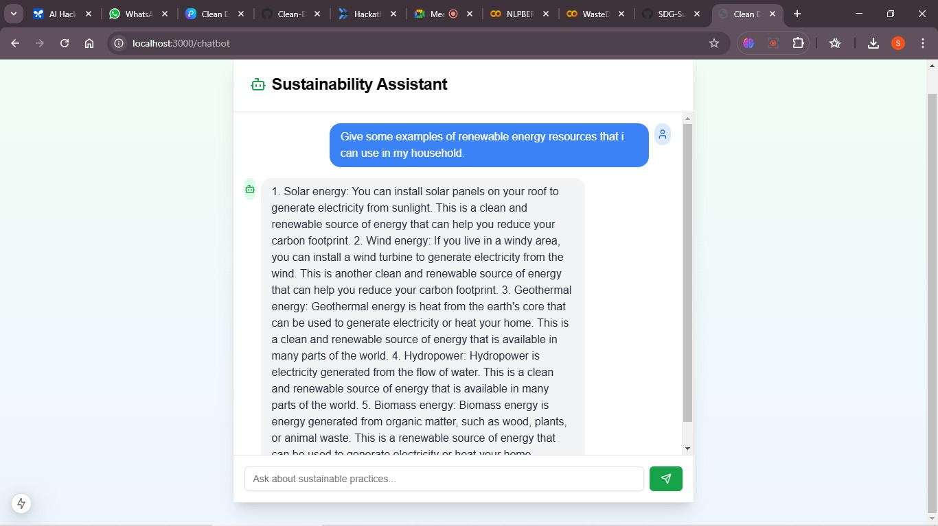

Slide 14
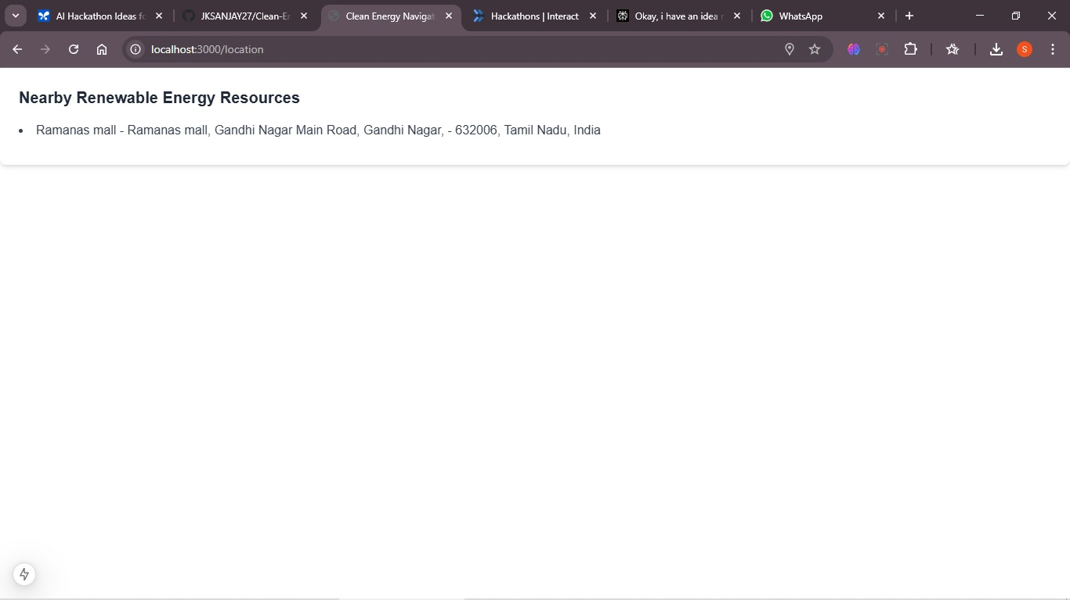

Slide 15
Resources
https://www.iisd.org/story/mapping-india-energy-policy-2023/
https://www.orfonline.org/research/evaluating-readiness-for-renewable-energy-adoption-in-india-a-multi-state-survey-of-industrial-and-residential-power-consumers
https://www.iea.org/commentaries/india-s-clean-energy-transition-is-rapidly-underway-benefiting-the-entire-world
https://www.investindia.gov.in/sector/renewable-energy

